Slide 1
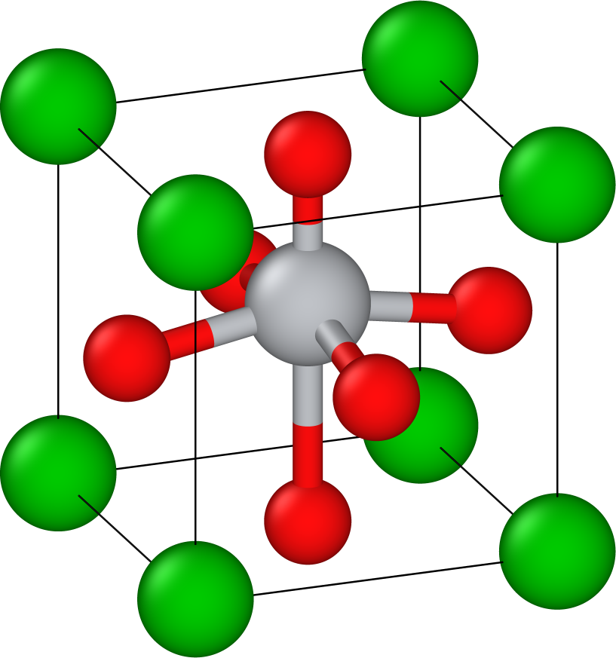
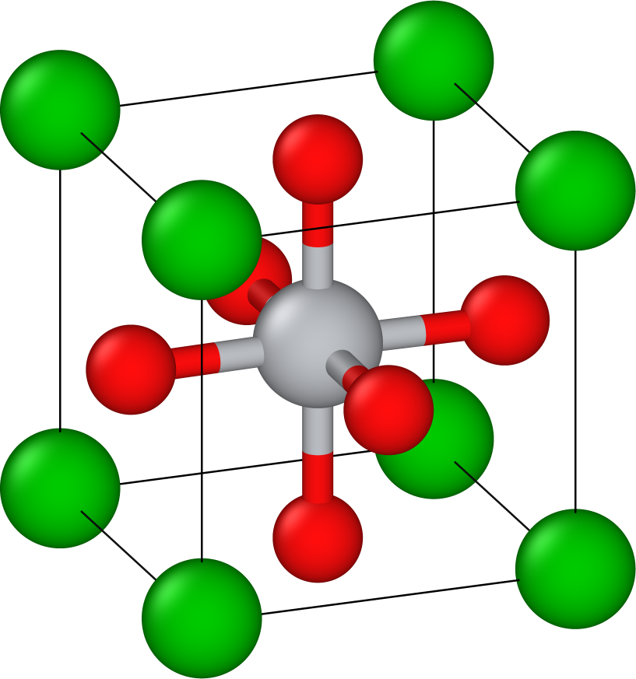
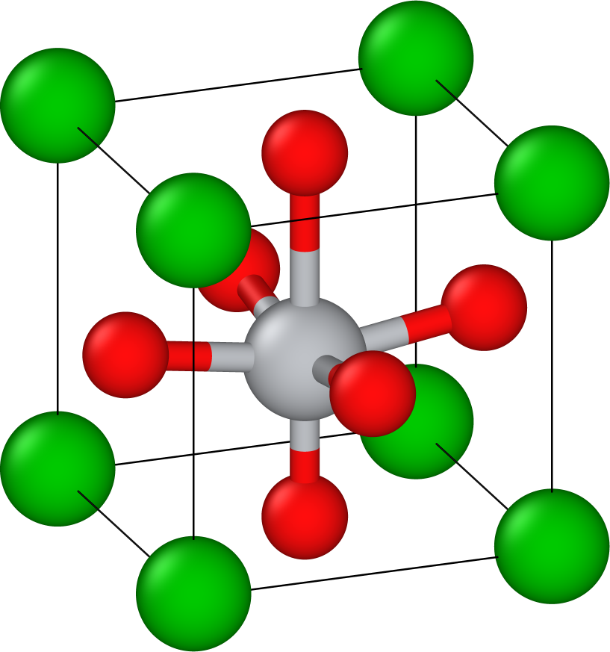
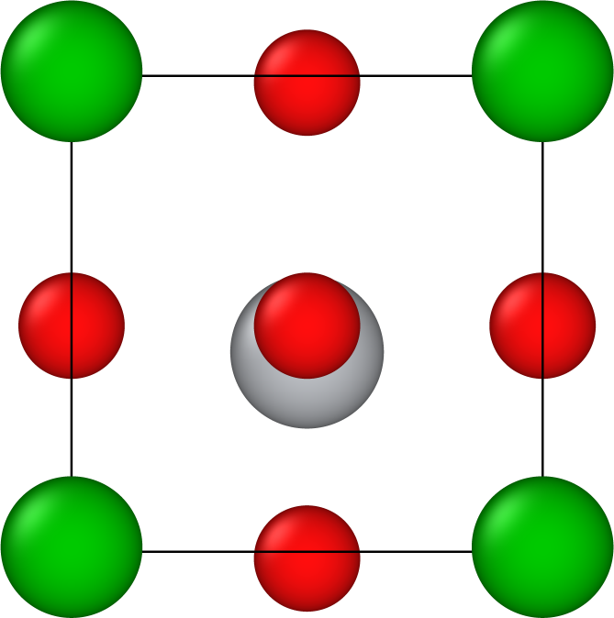

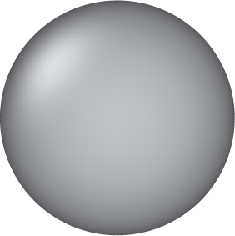
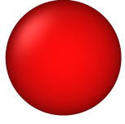
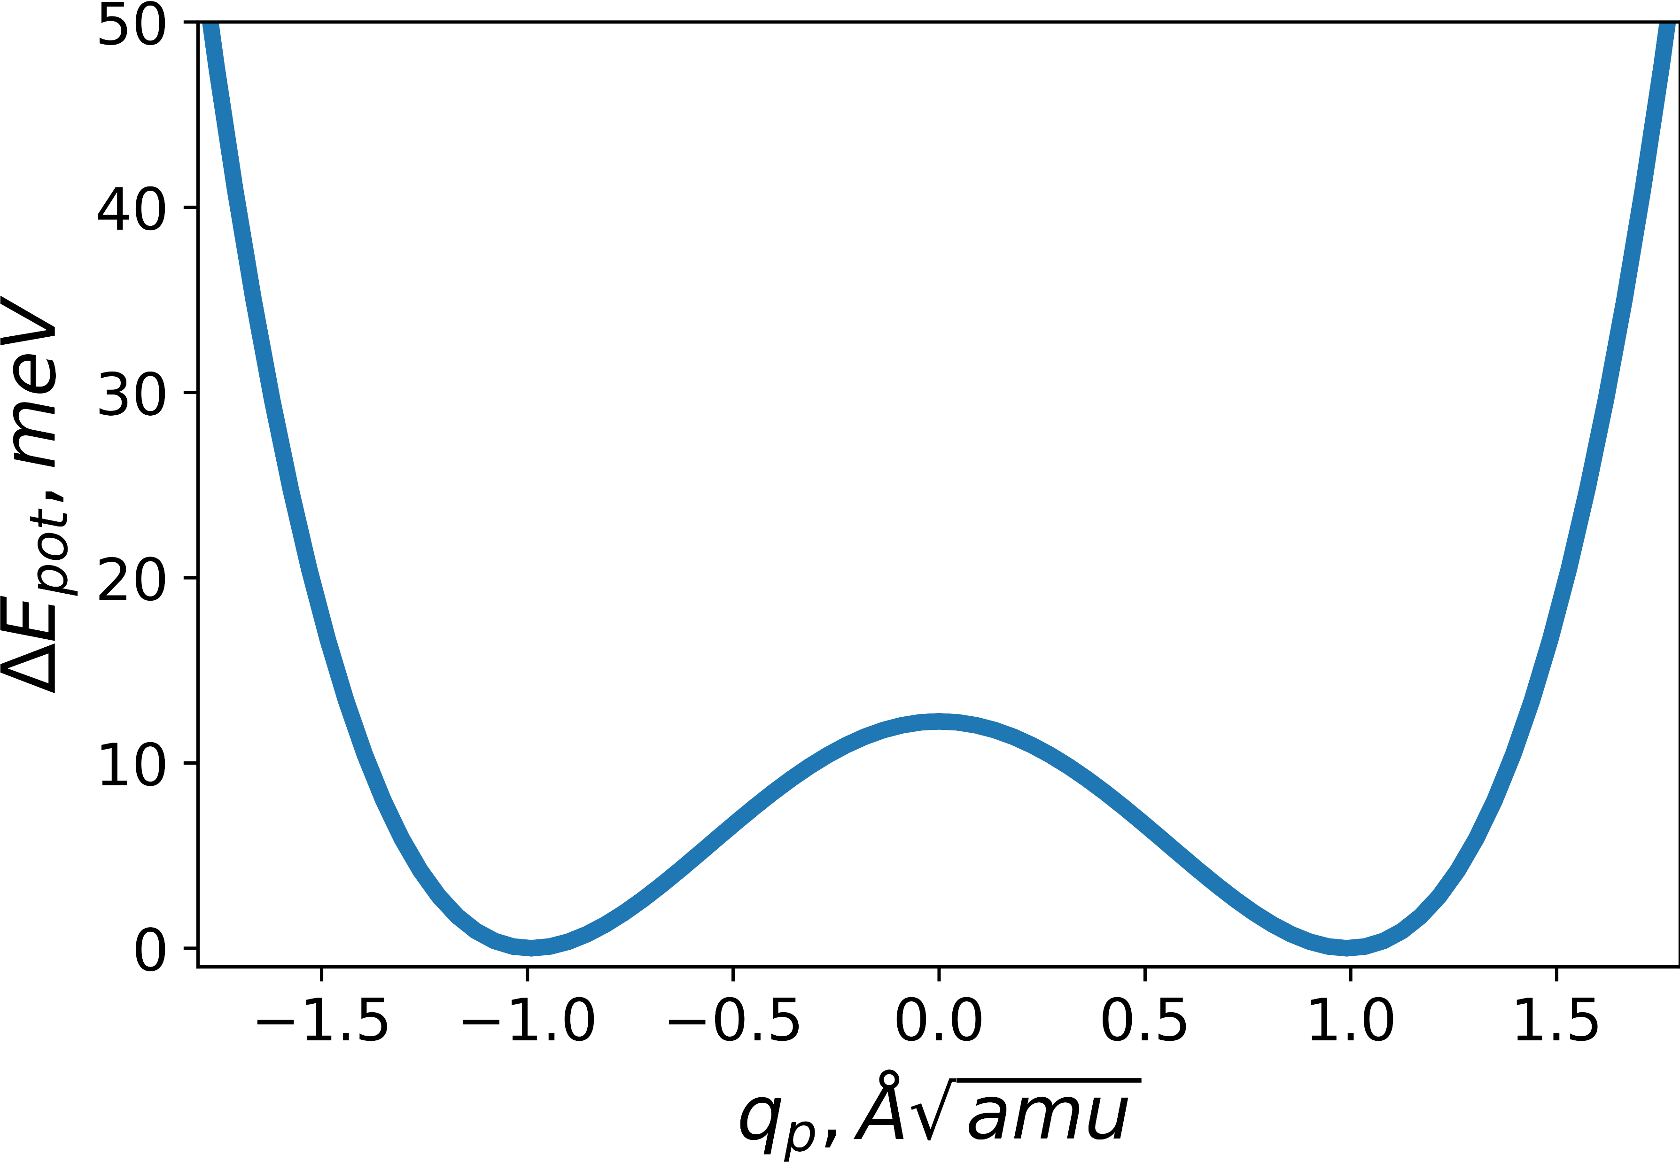
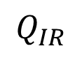
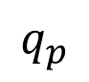
(A)
c
a
UP (U)
P > 0
NEUTRAL (N)
P = 0
DOWN (D)
P < 0
c
Ba
a
Ti
O
$$q_{p}$$
$$Q_{IR}$$
(B)
12 meV
(N)
(U)
(D)

Slide 2
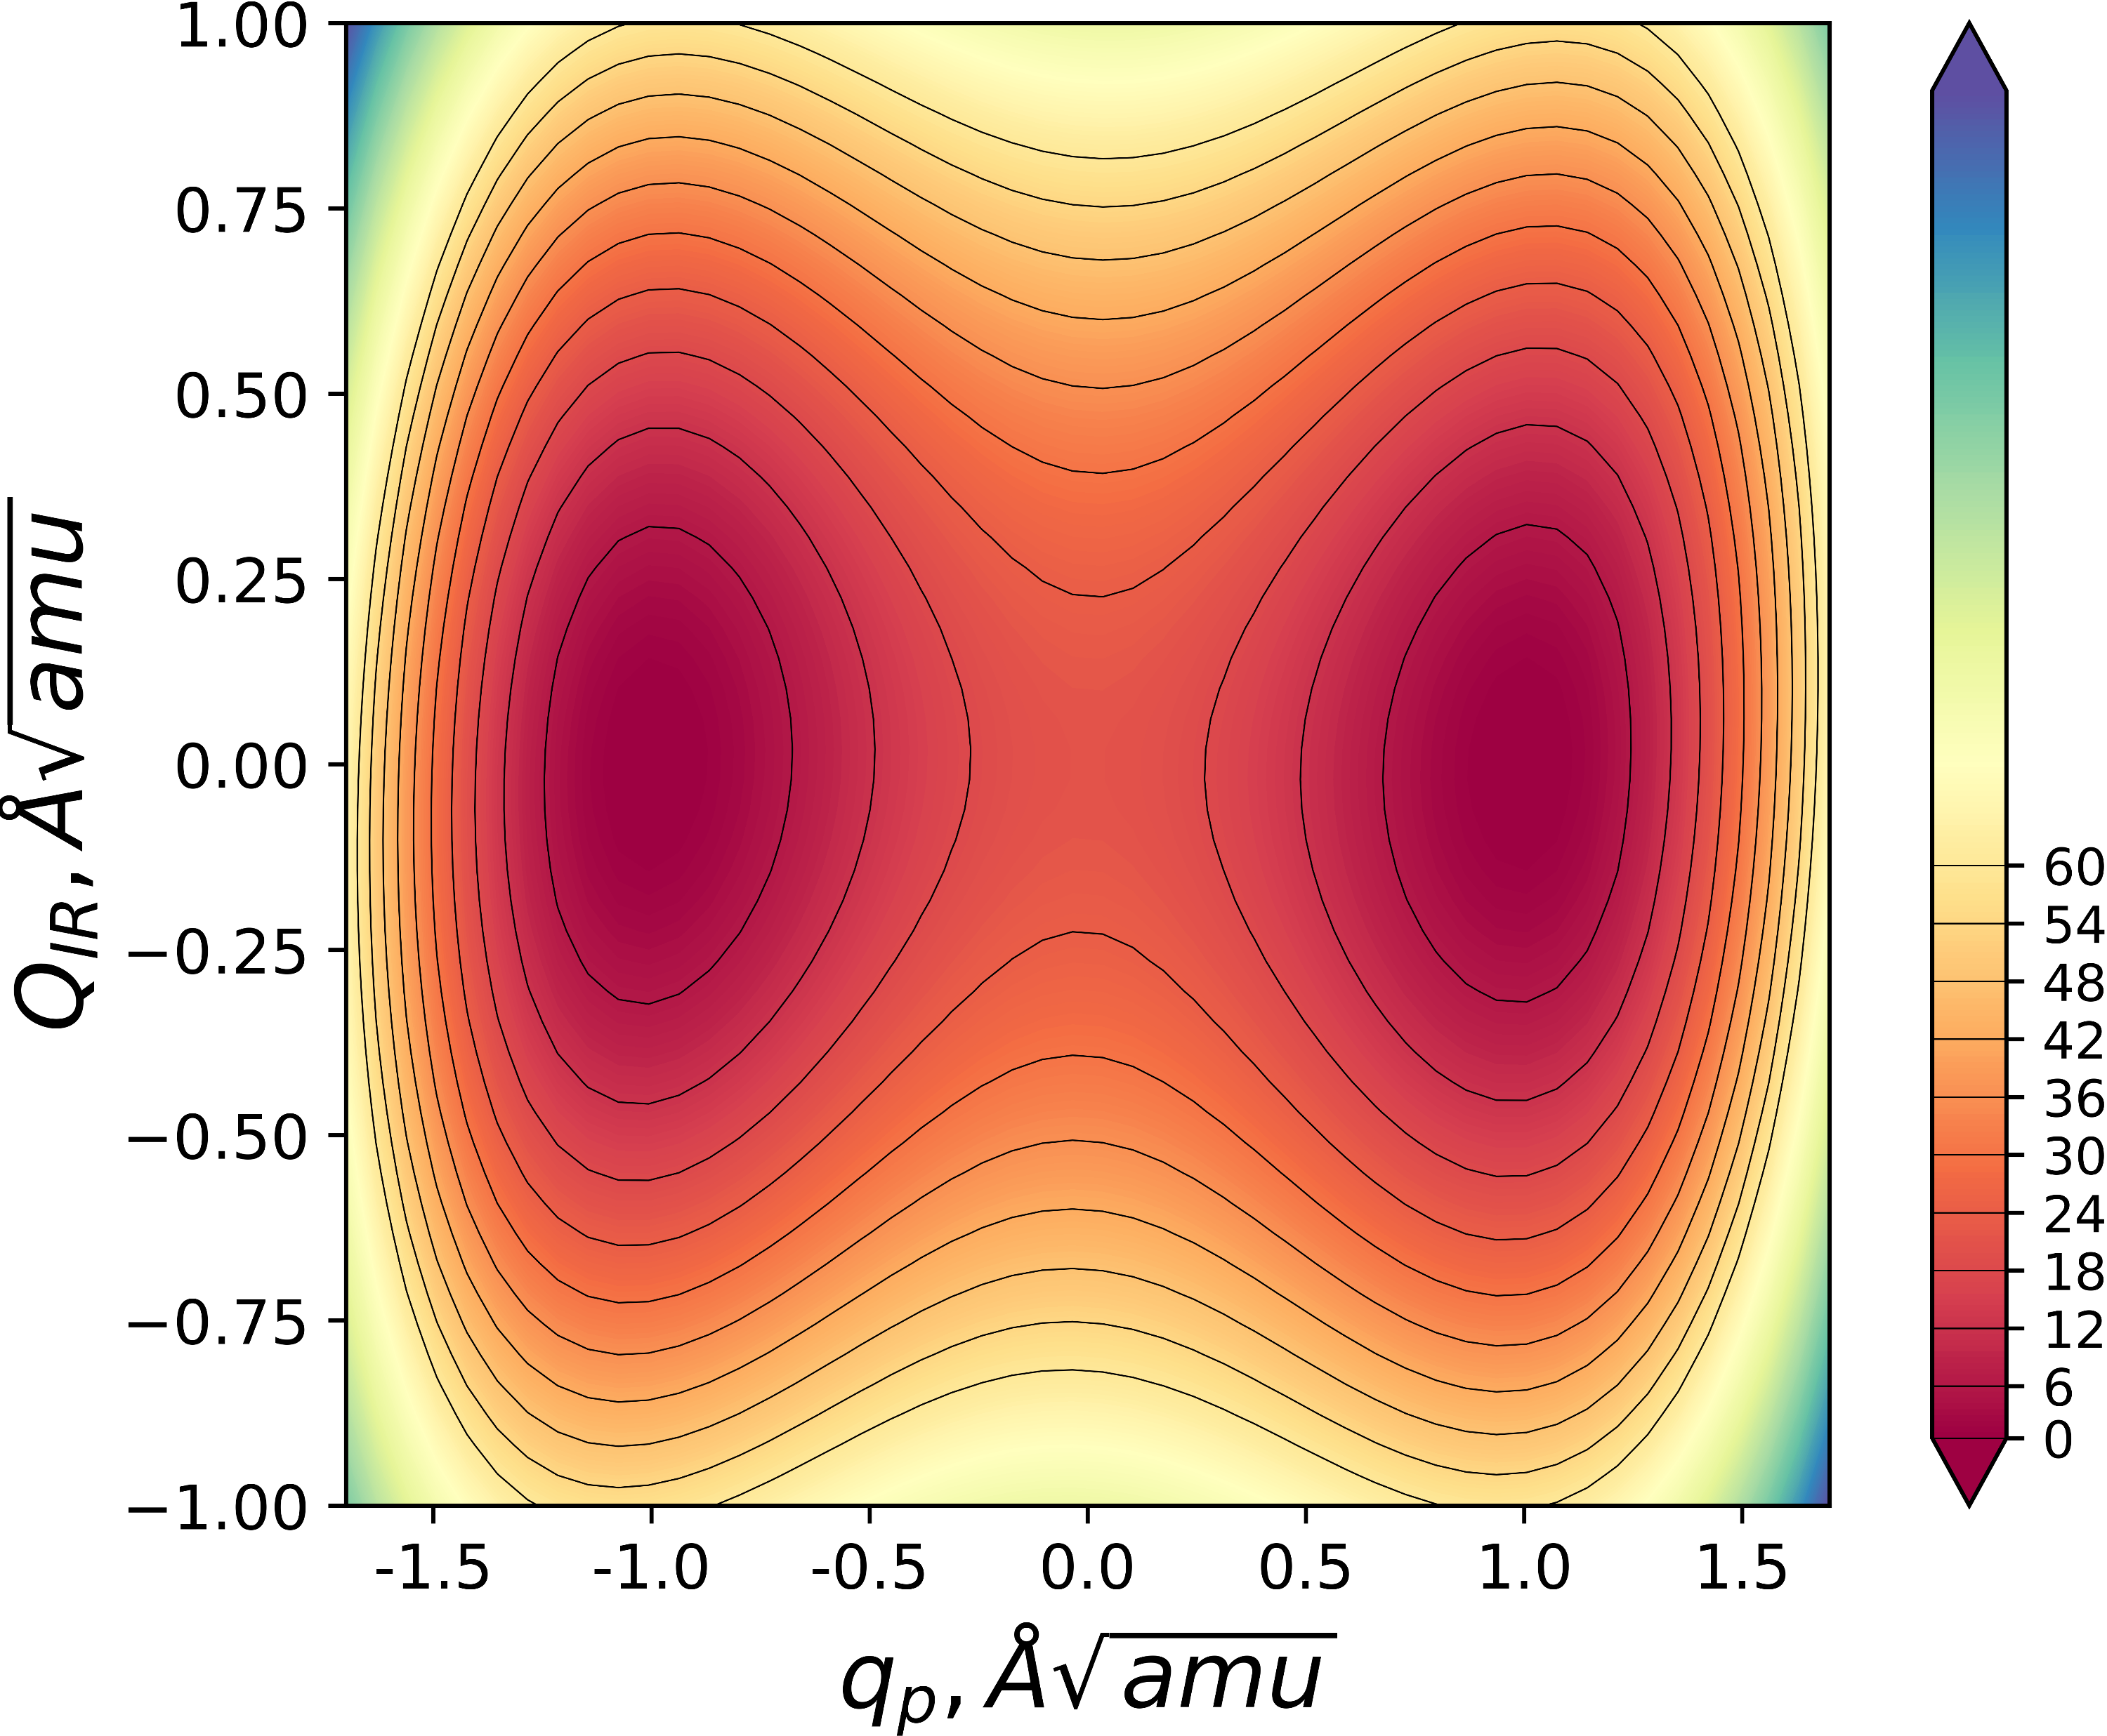

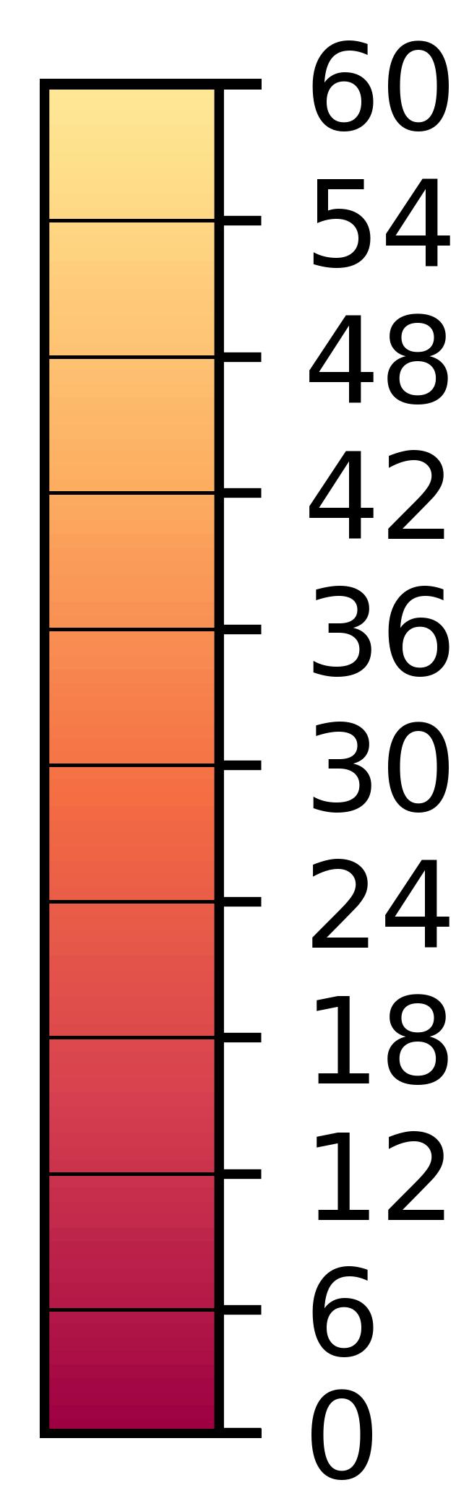
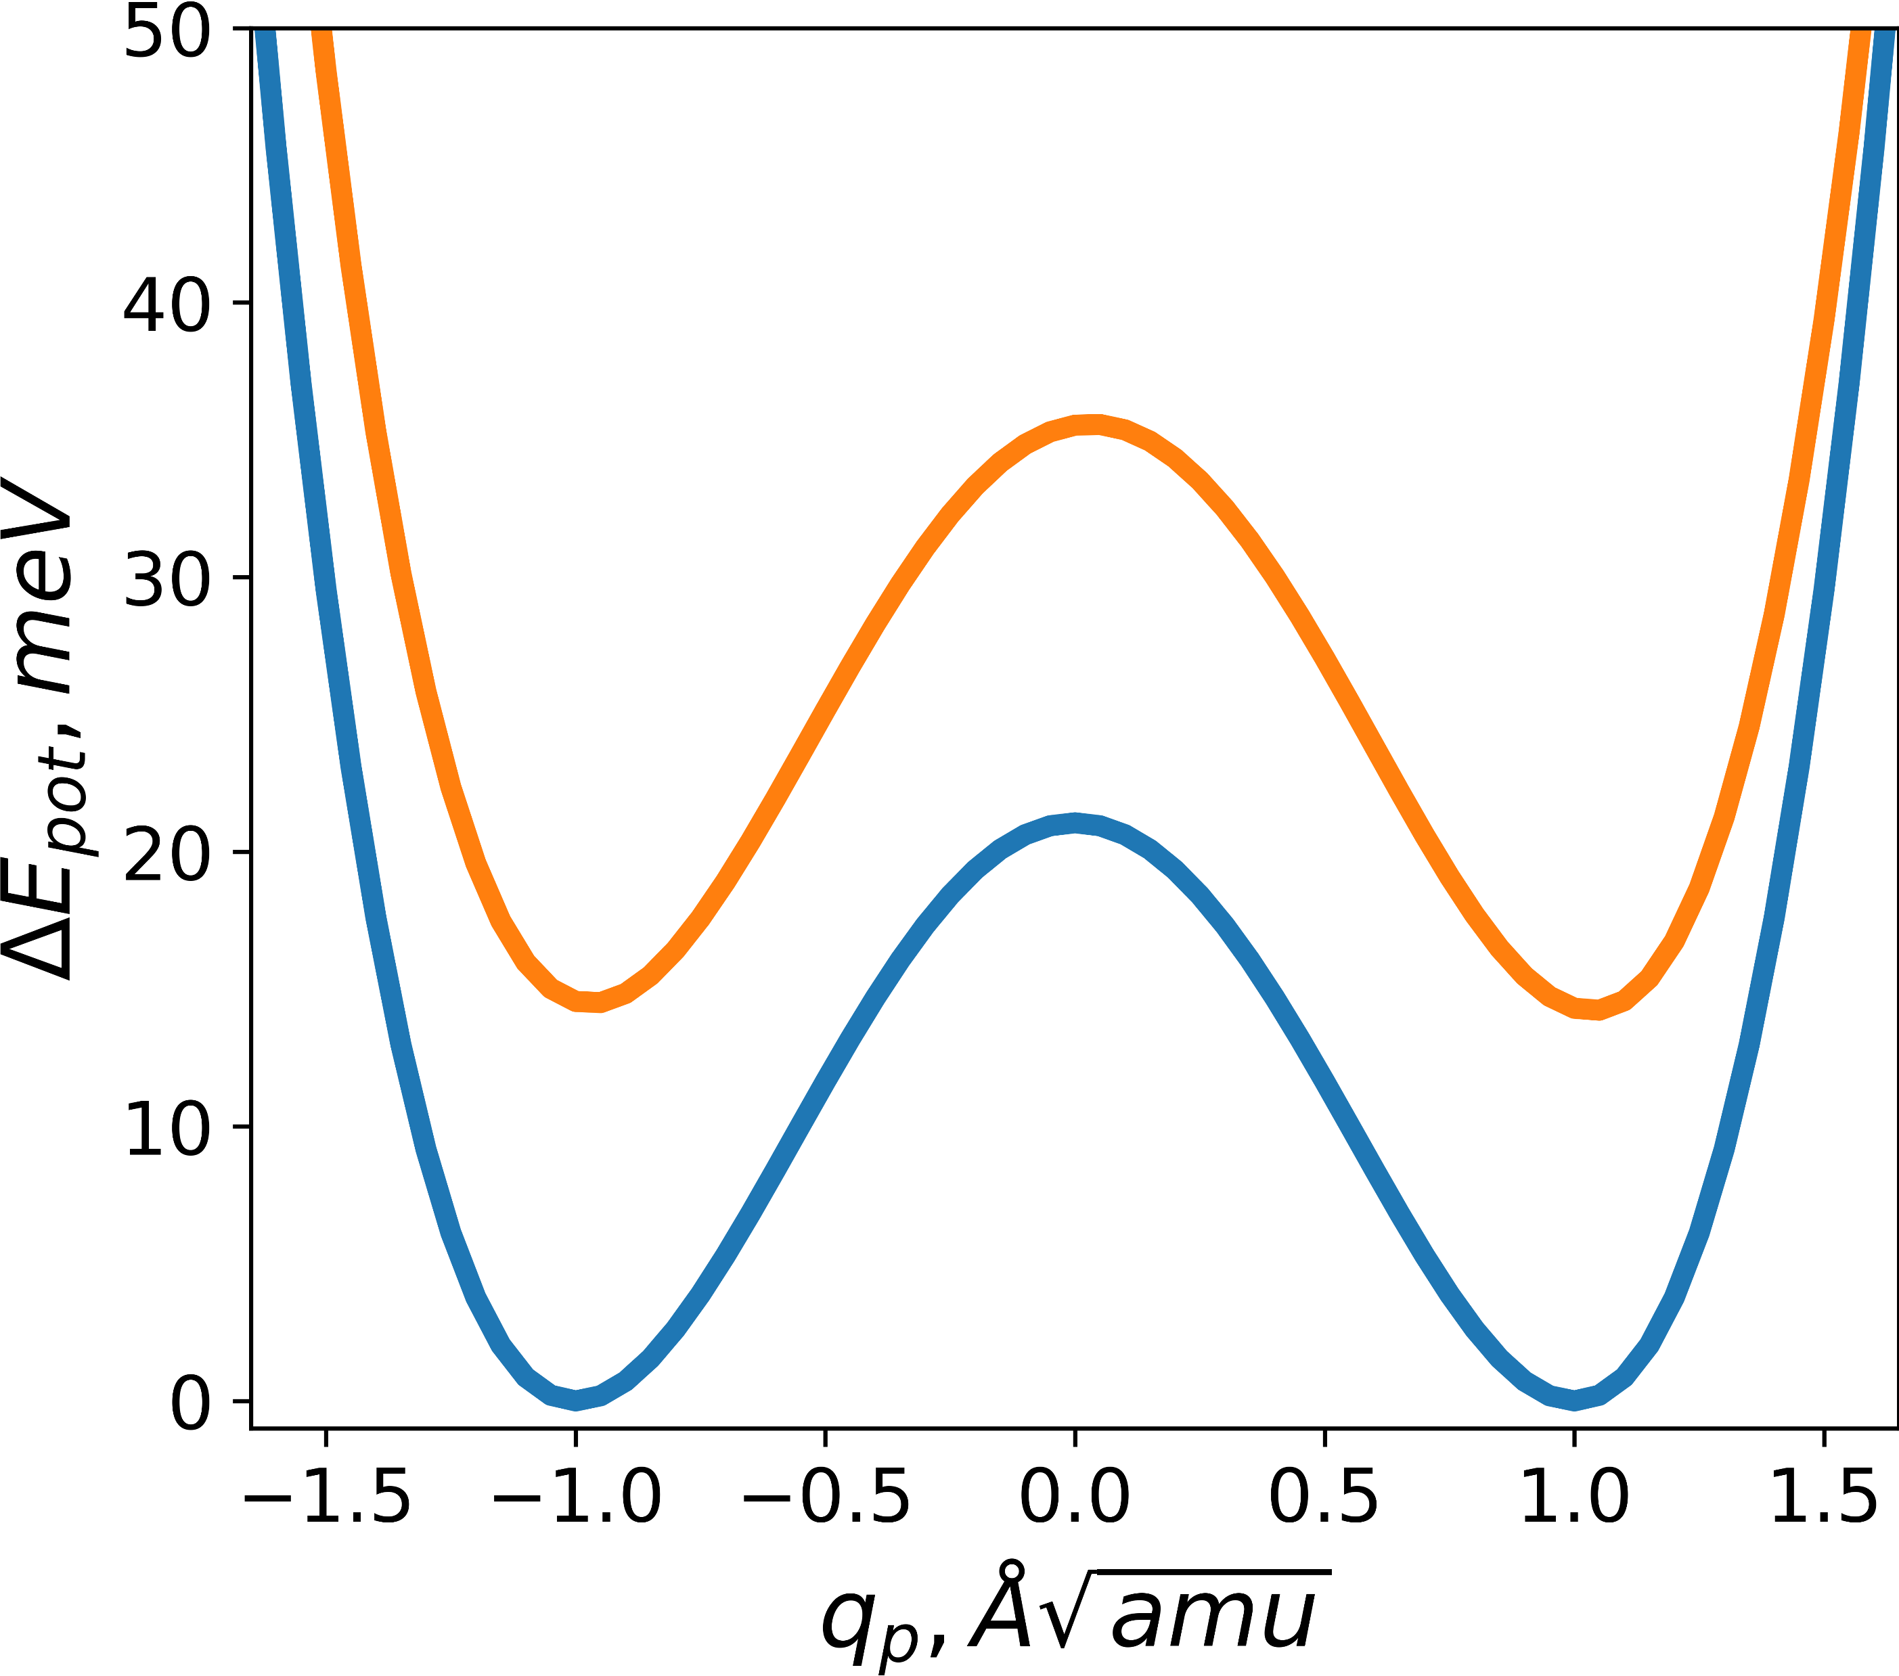
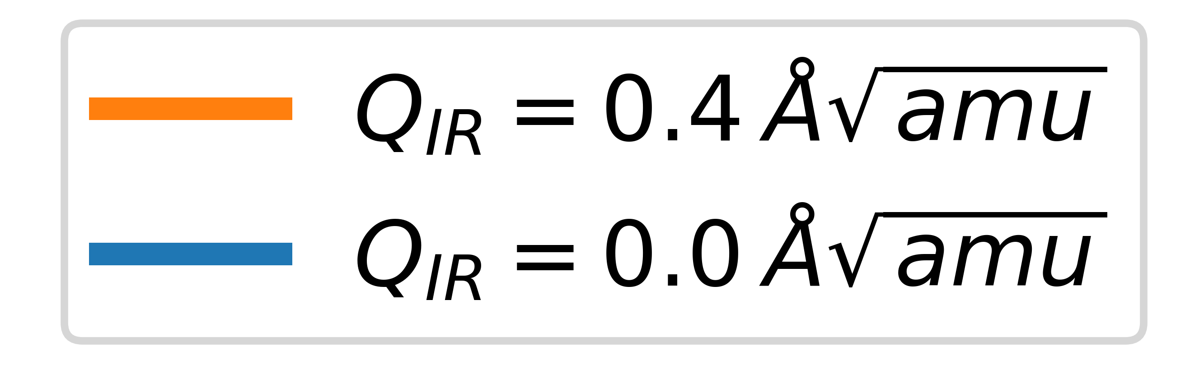

Slide 3
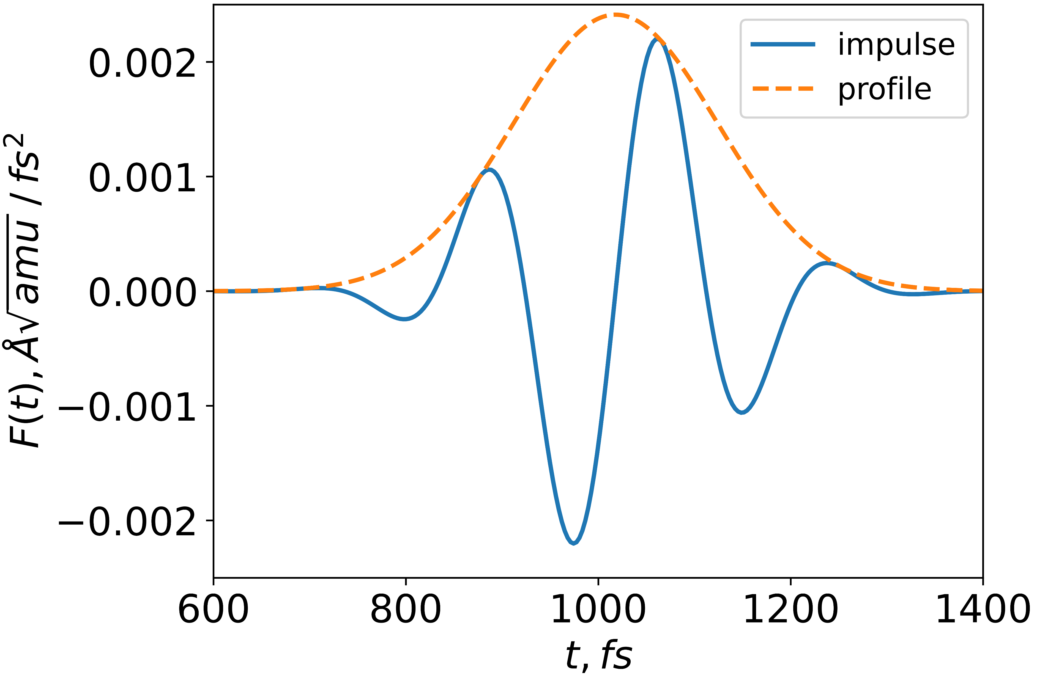
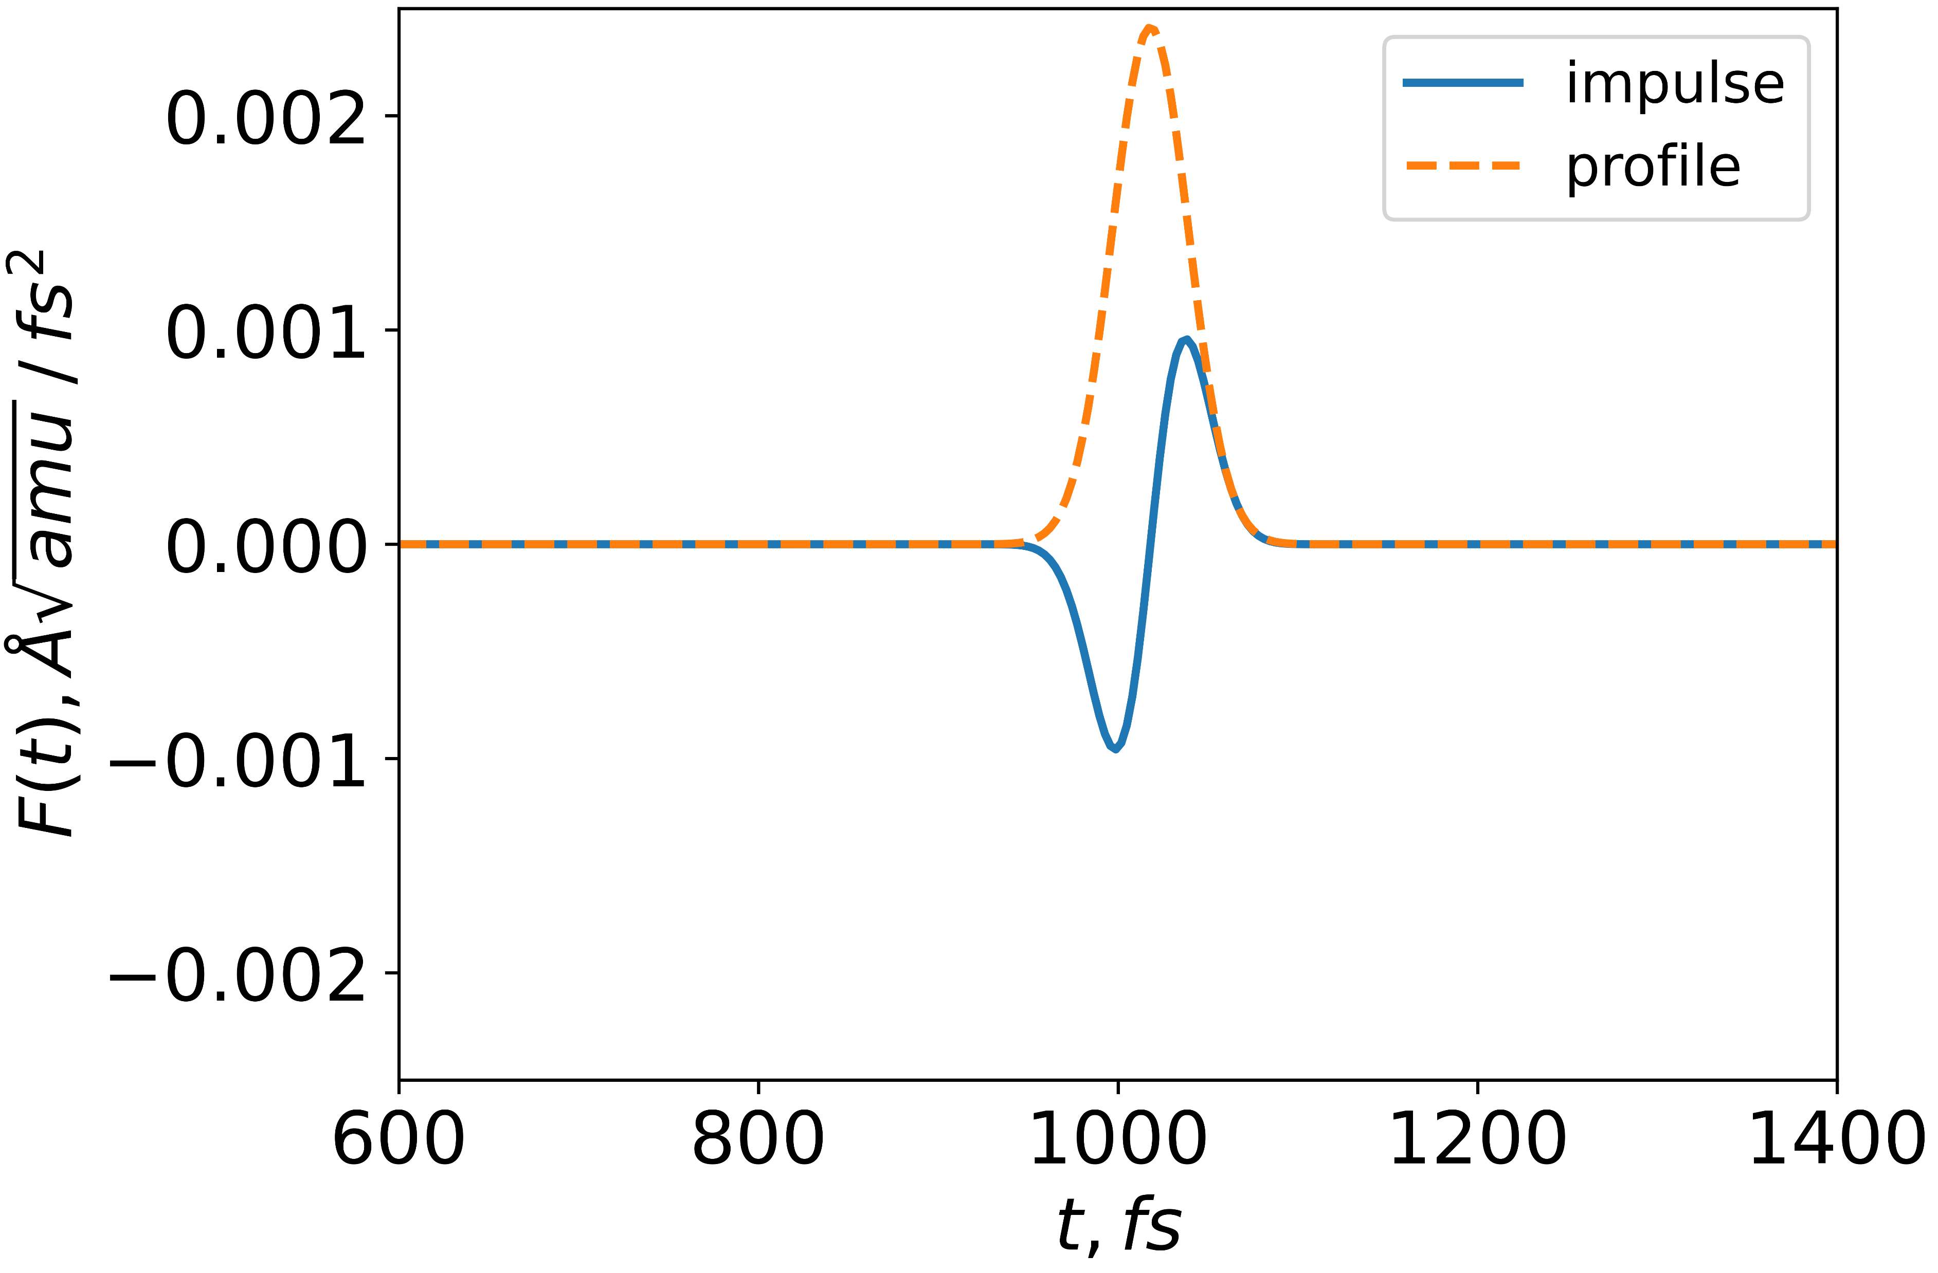
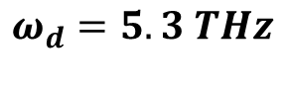

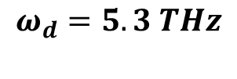

$$τ=250 fs$$
$$ω_{d}=5.3 THz$$
$$τ=50 fs$$
$$ω_{d}=5.3 THz$$

Slide 4
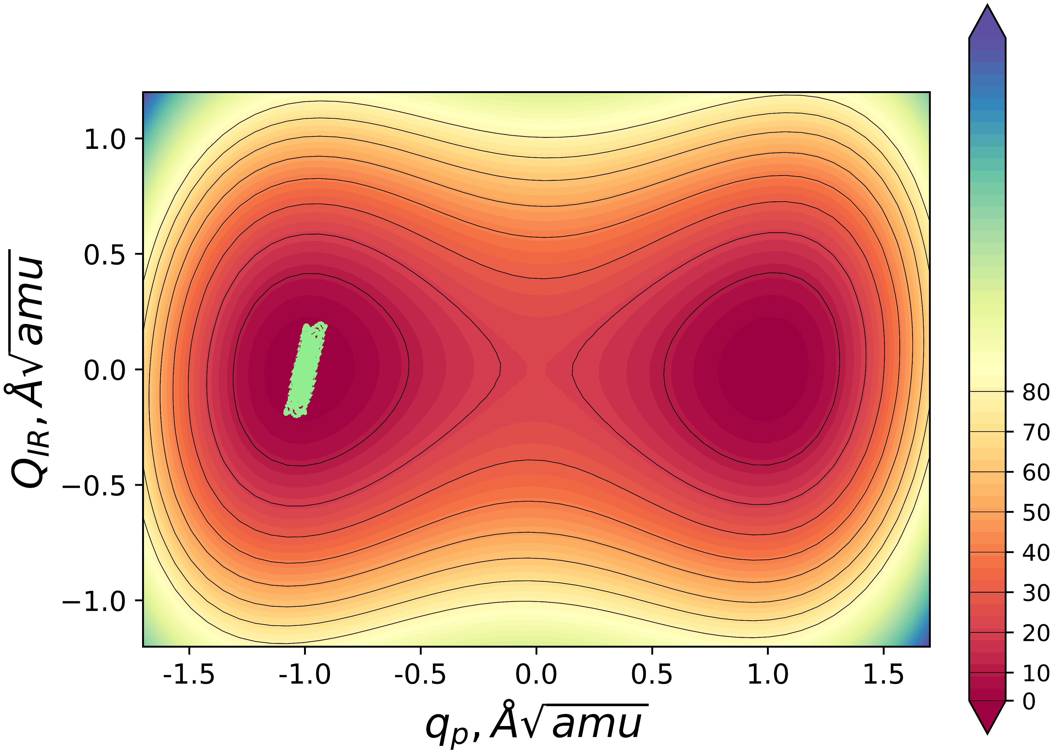
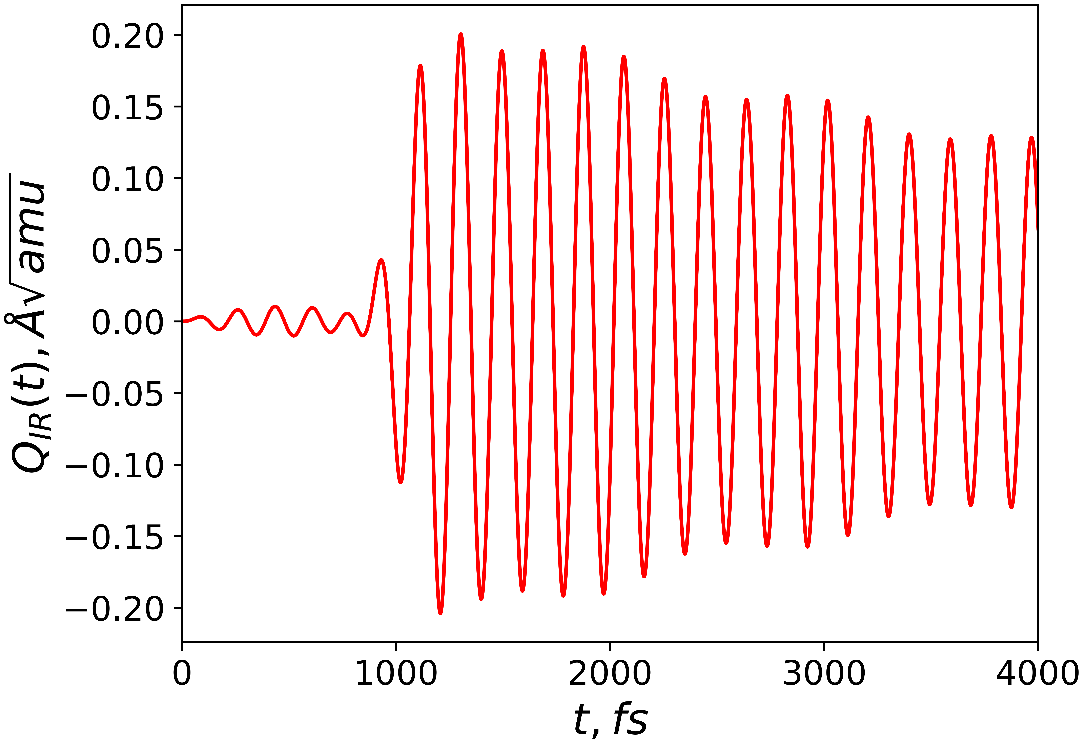
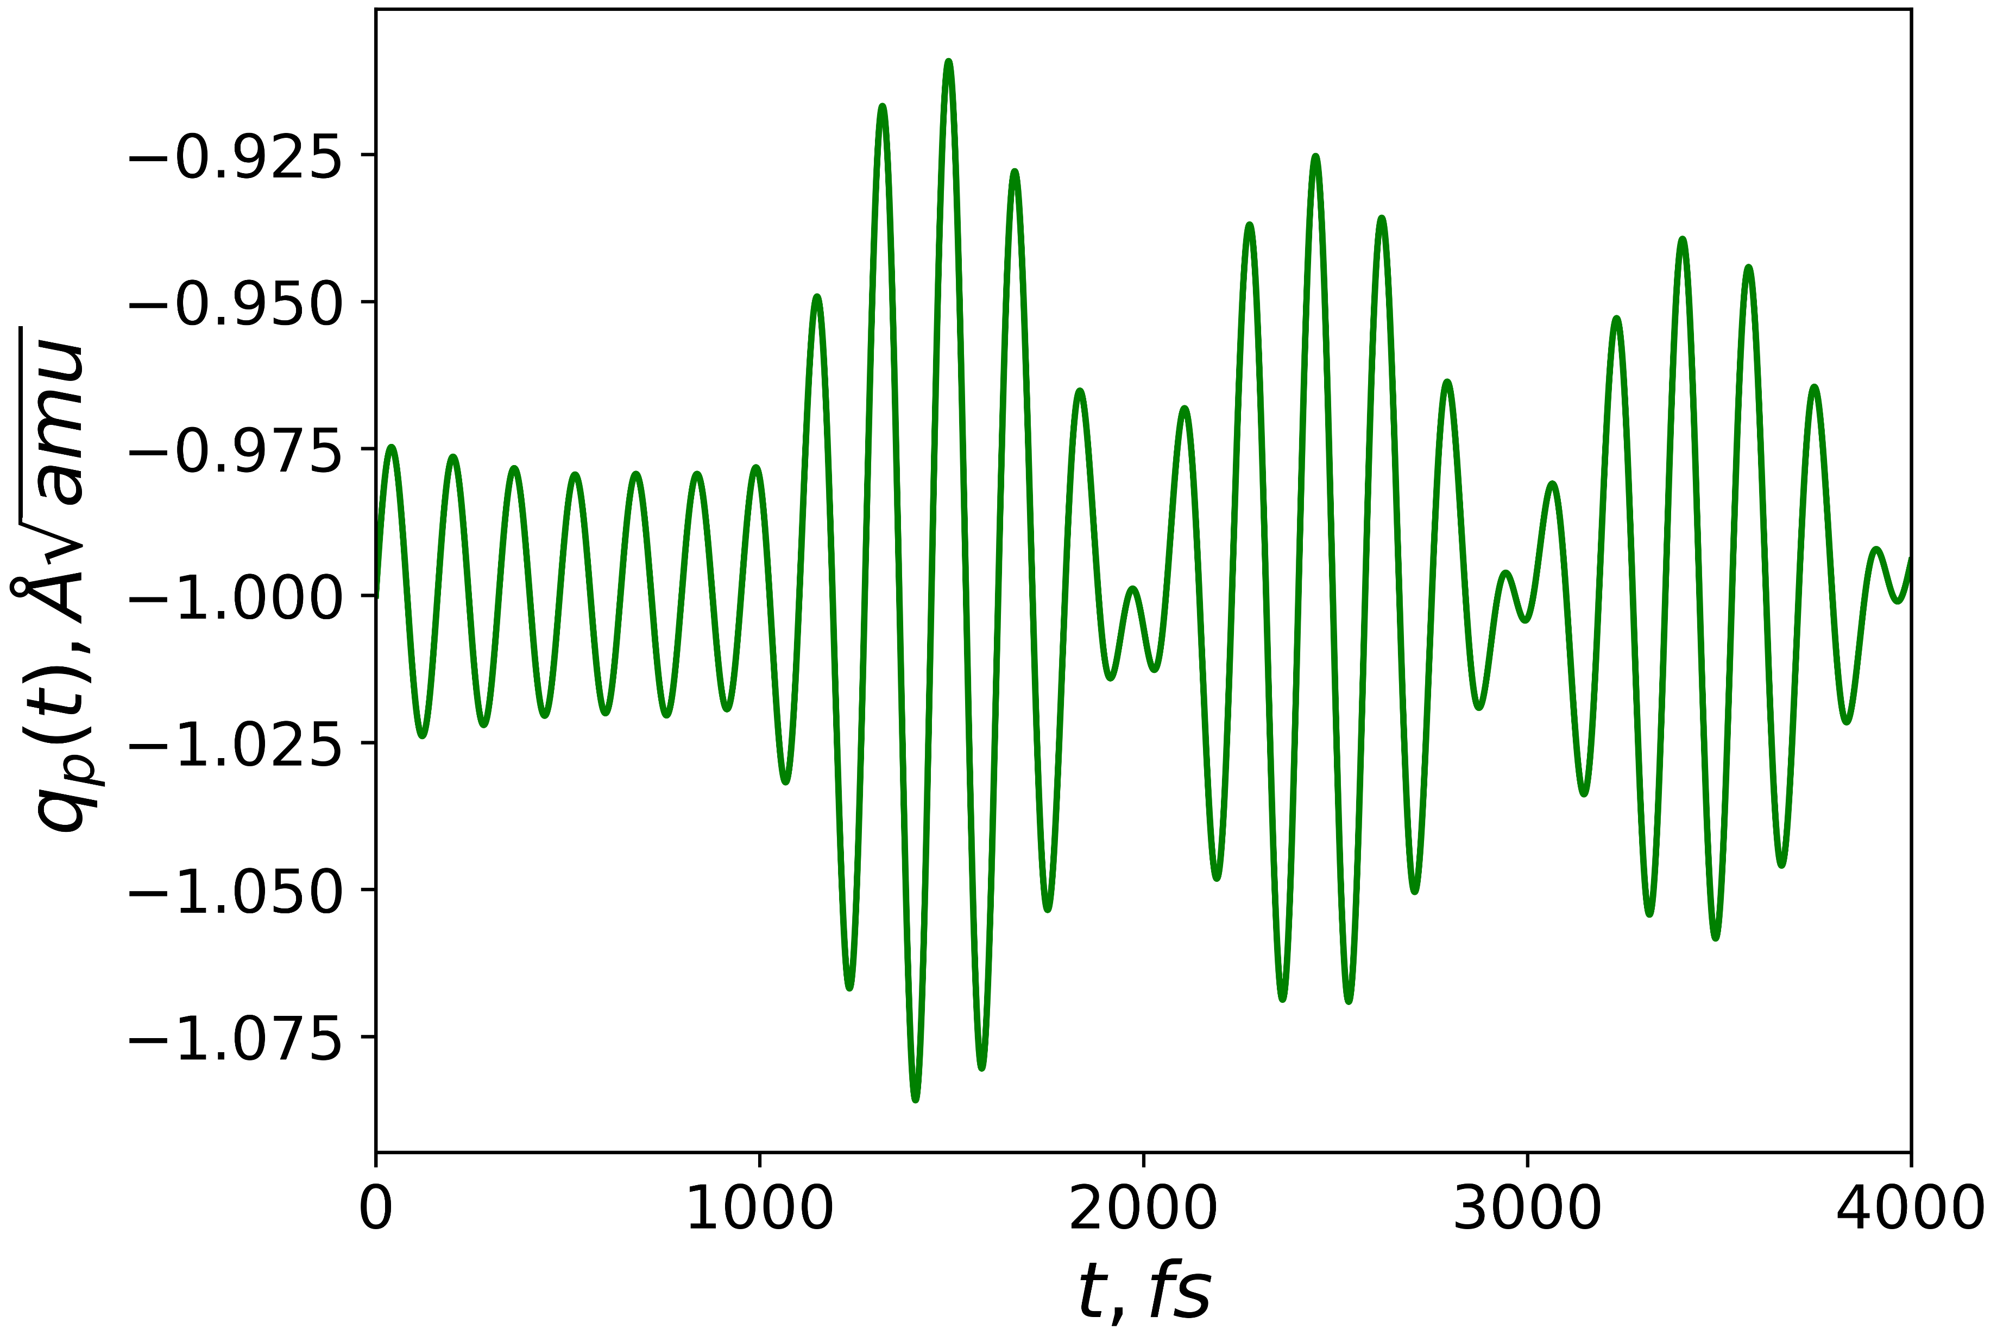
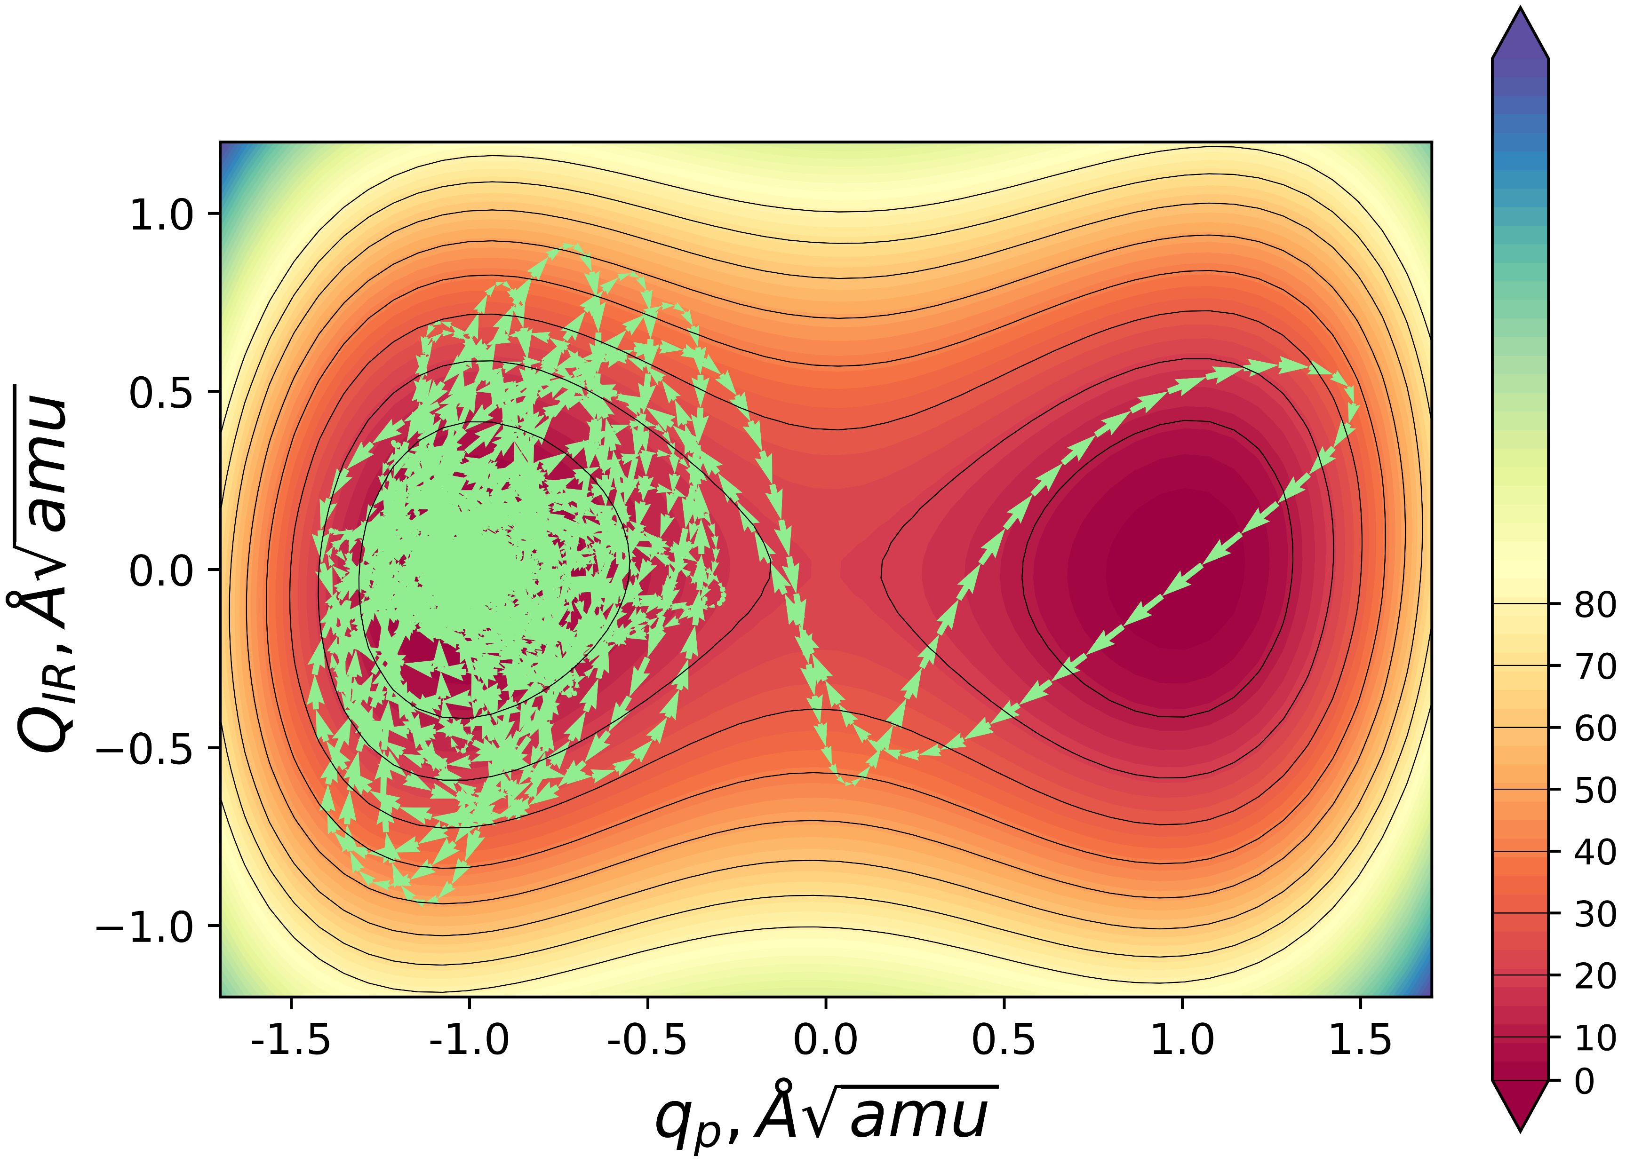
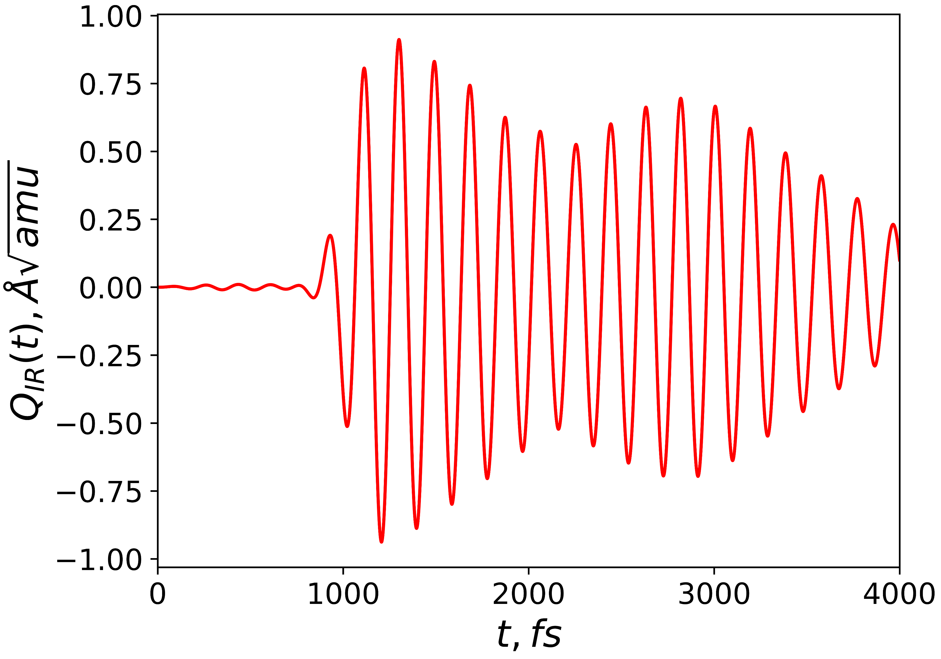
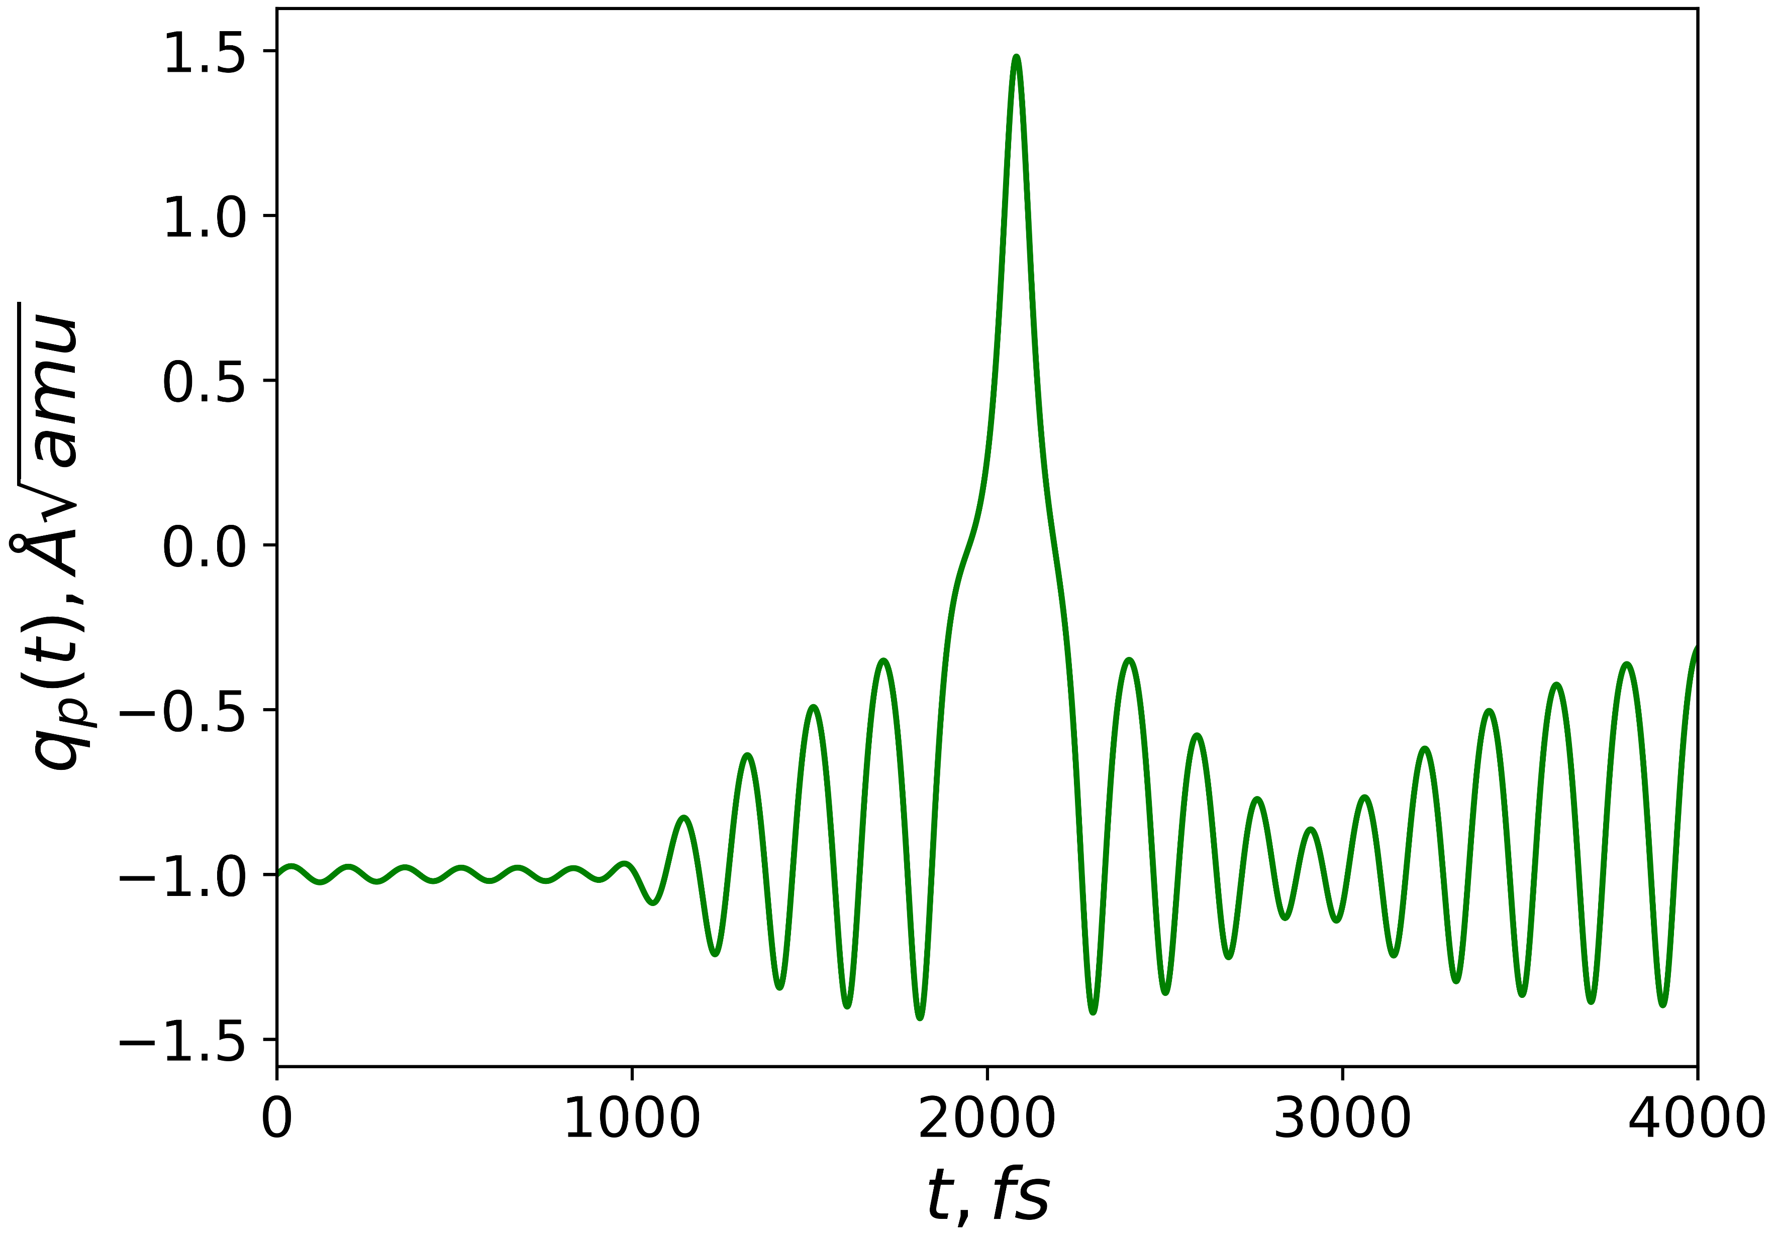
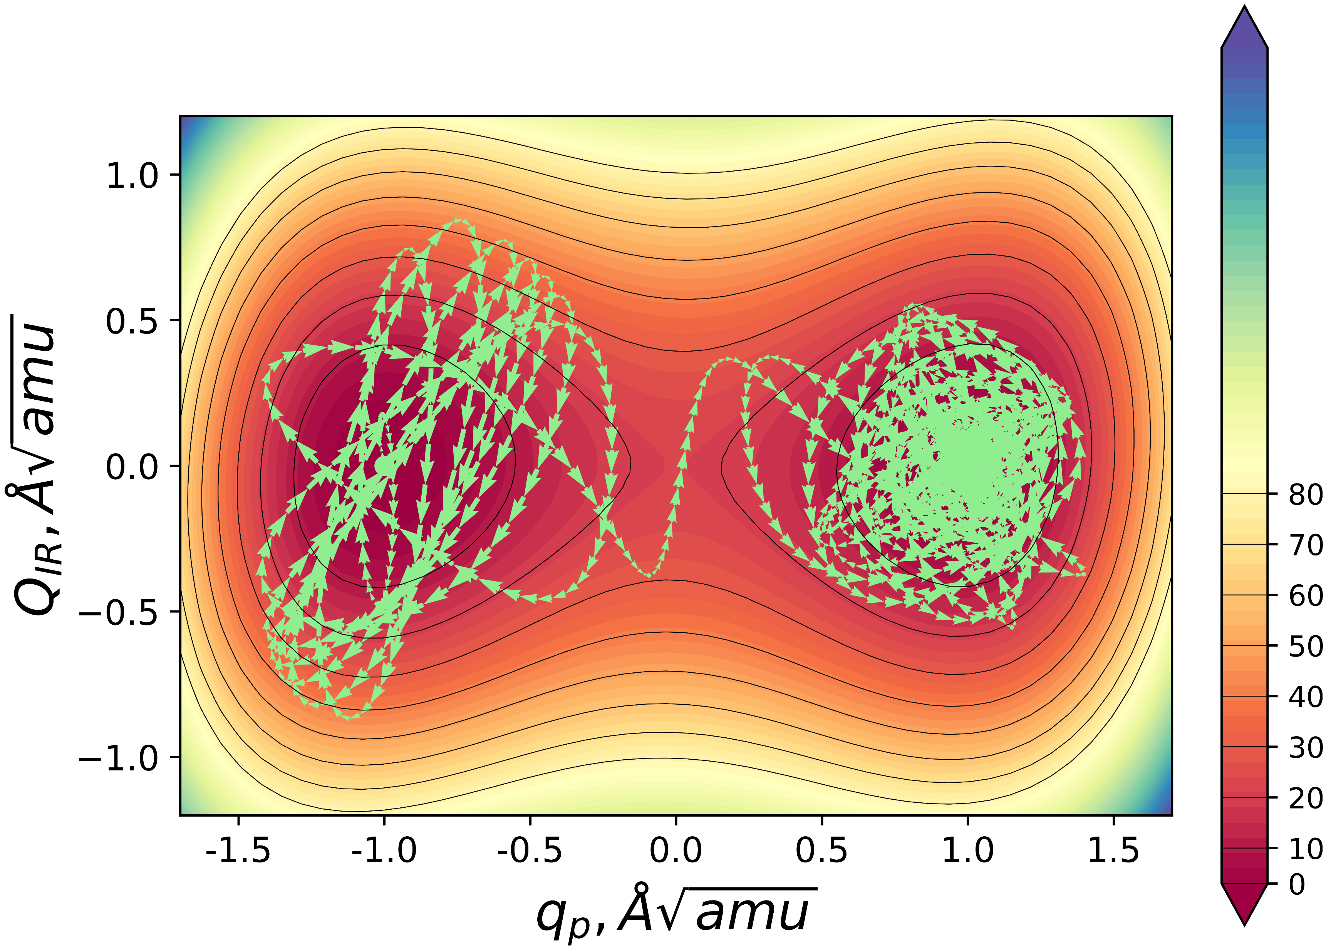
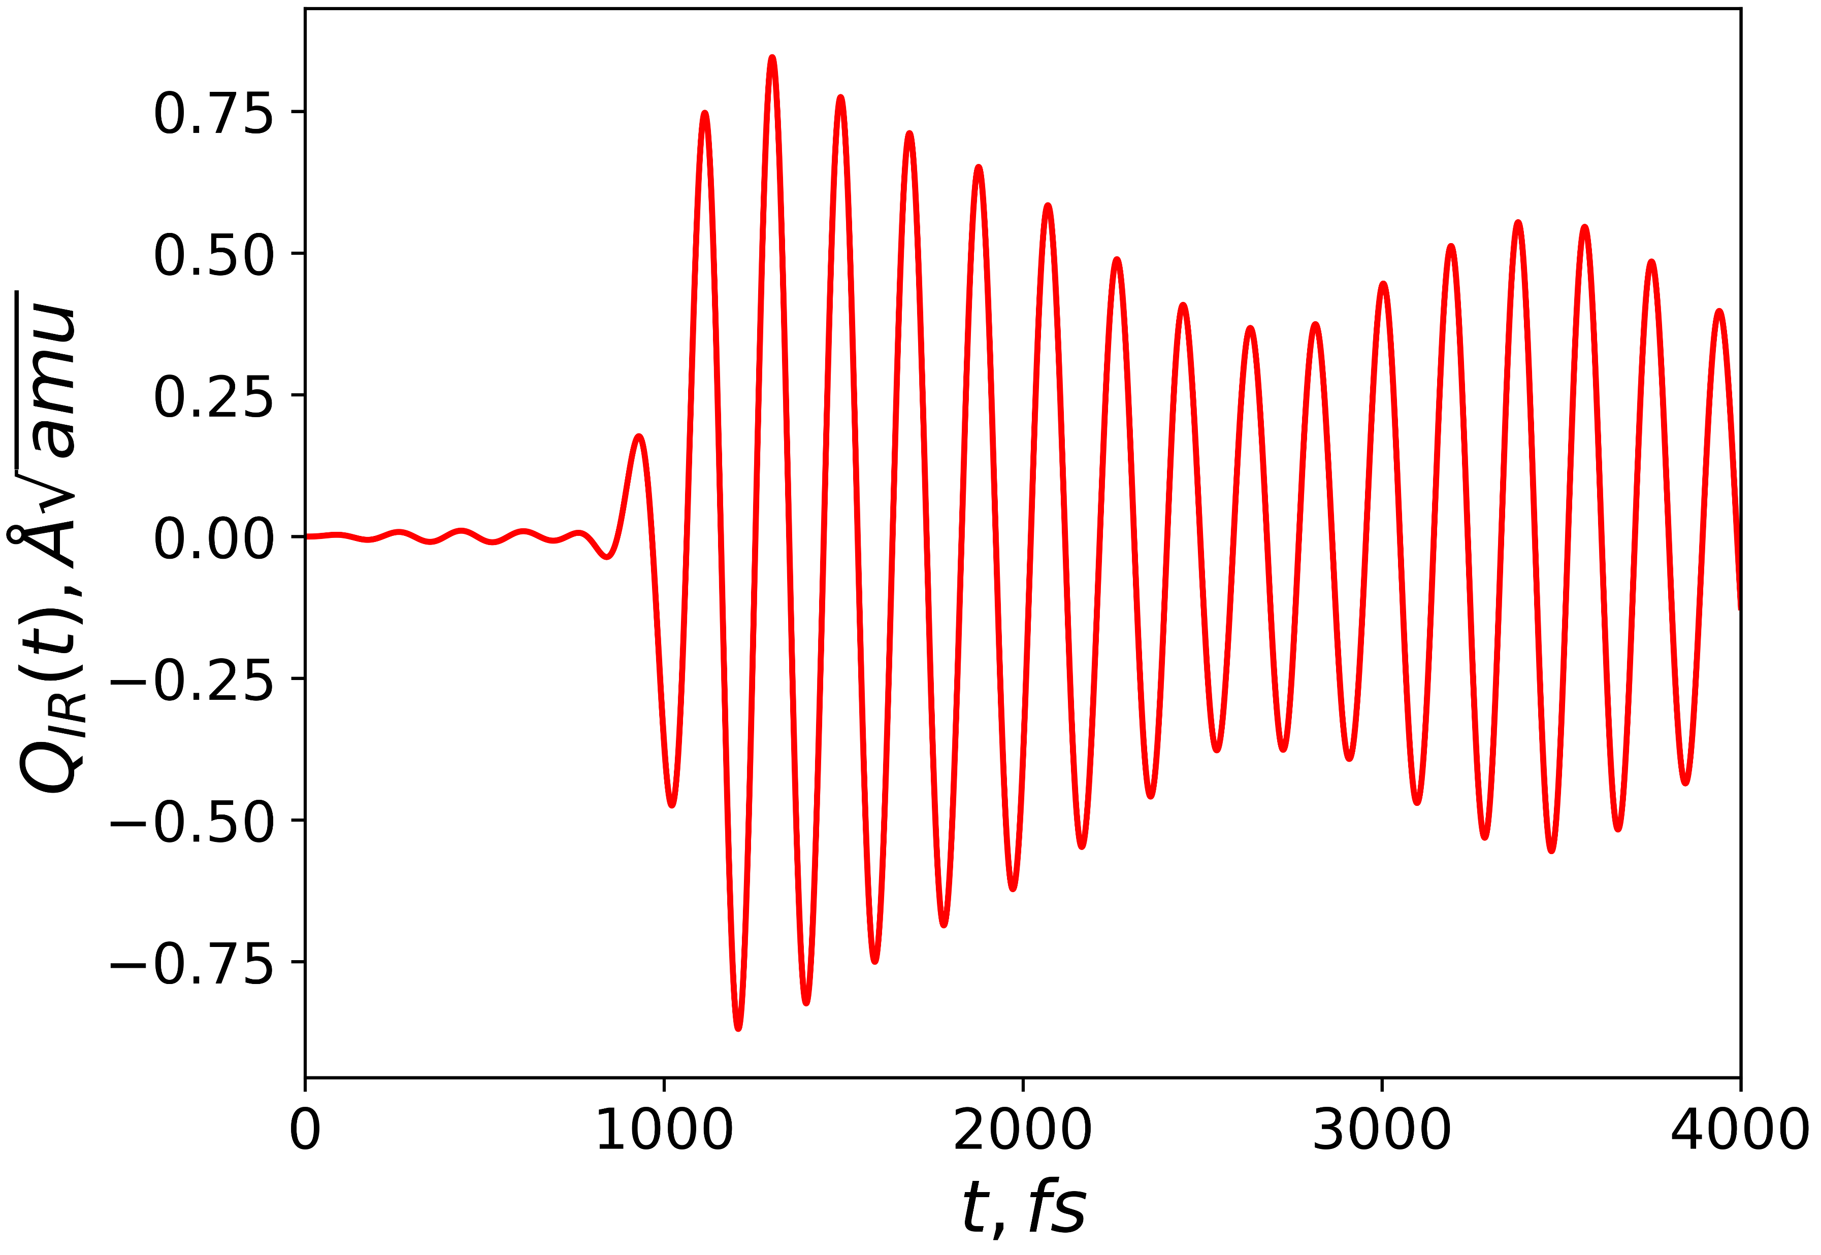
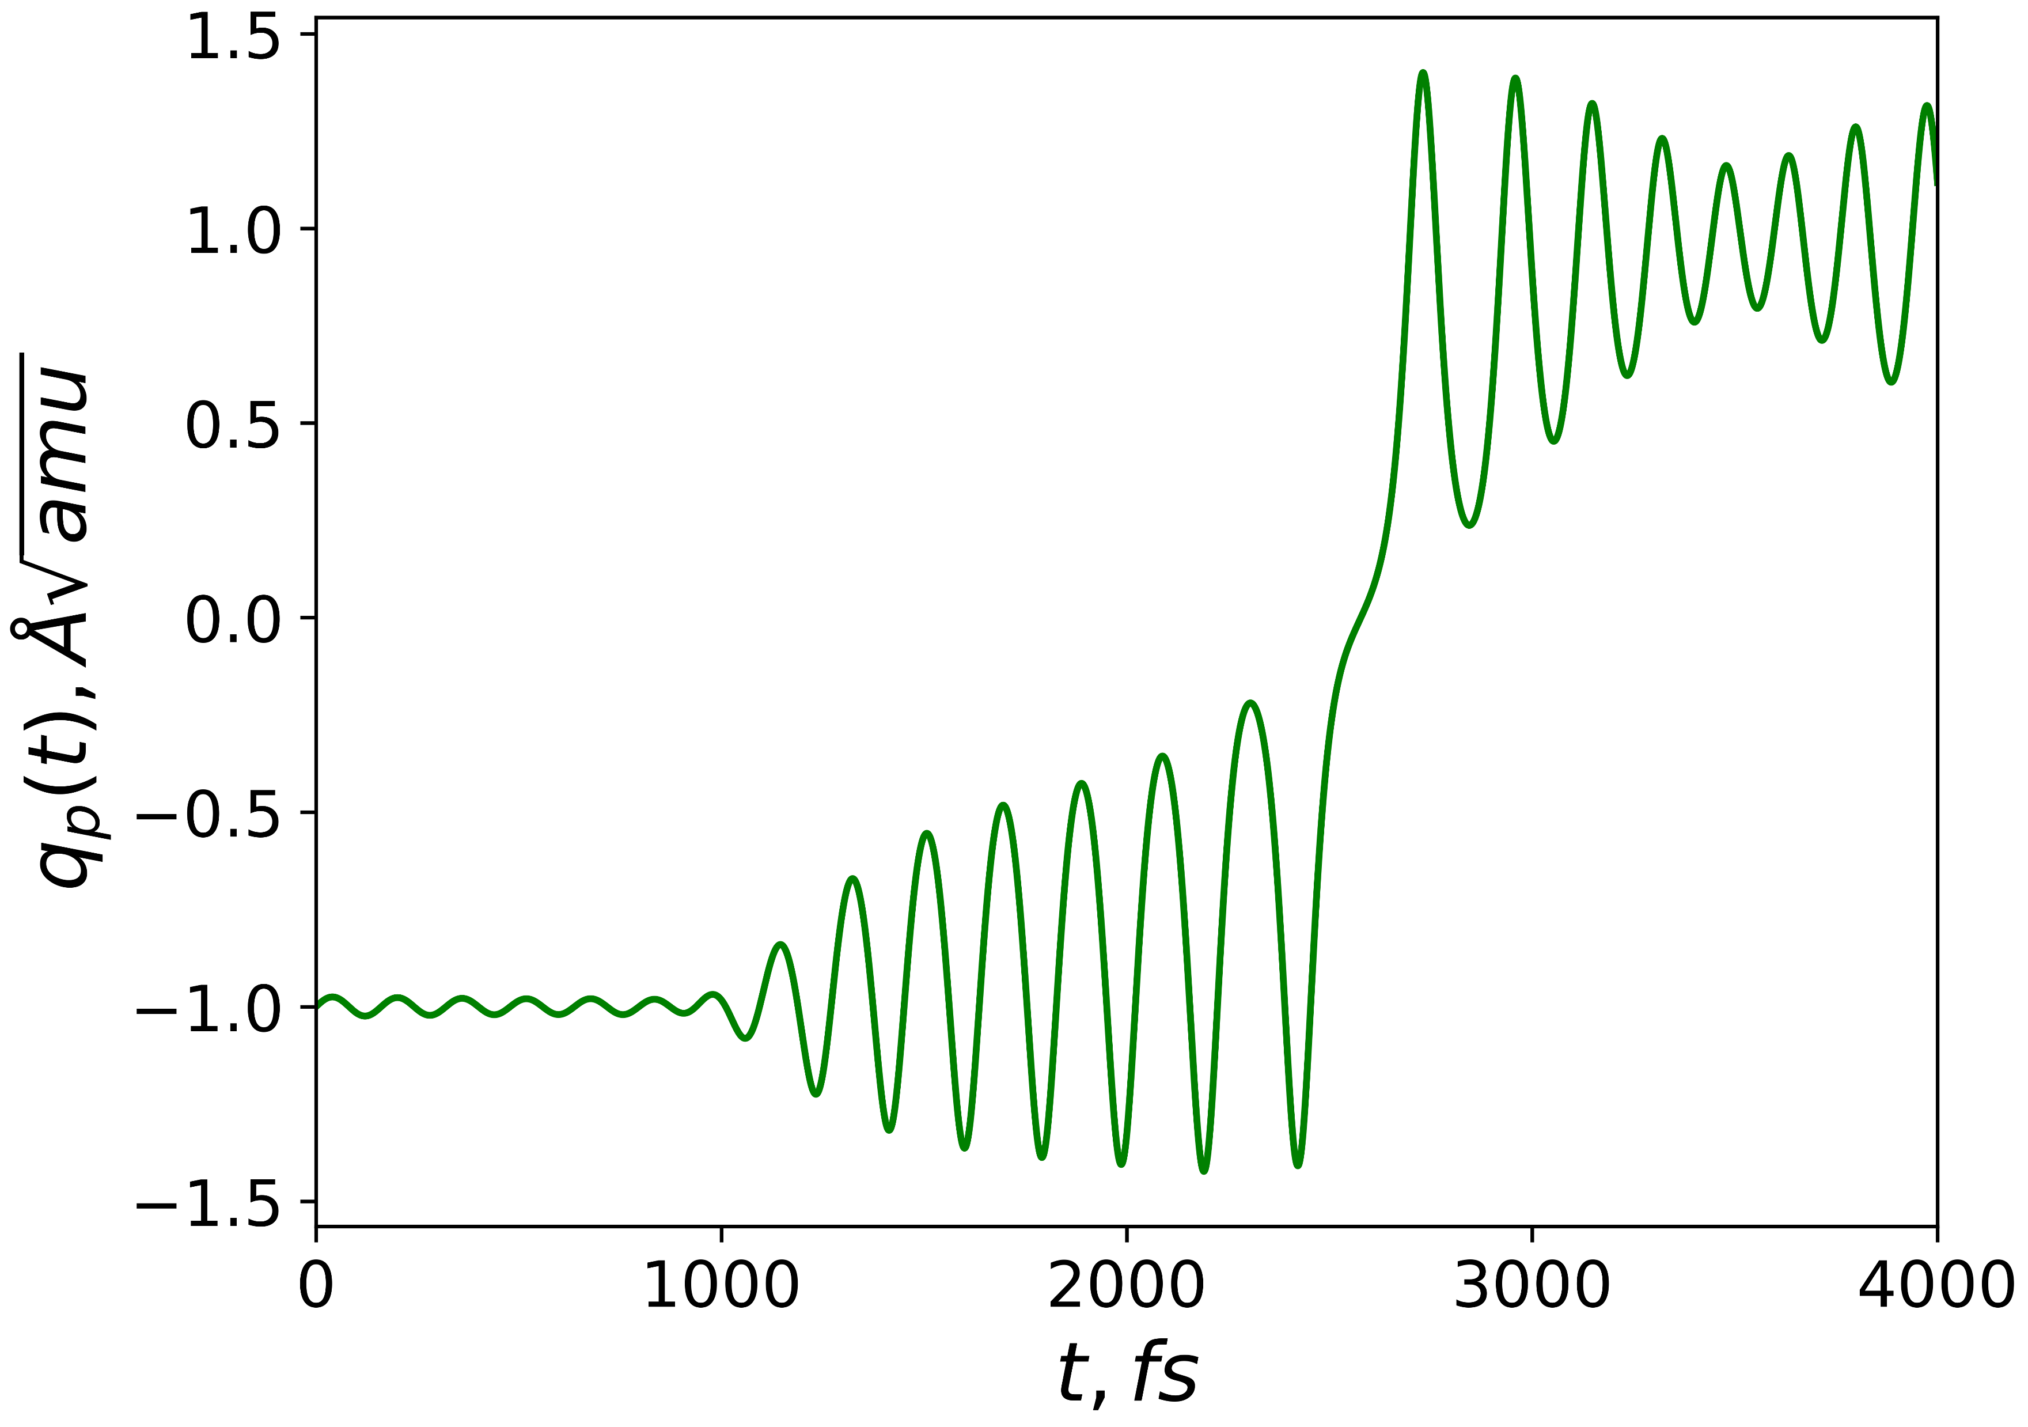
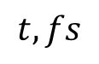
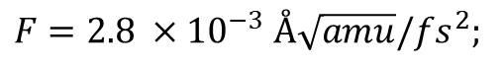
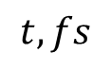
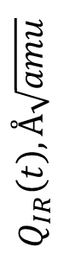

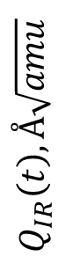
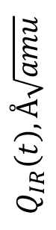
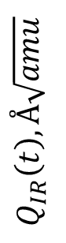

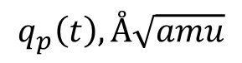
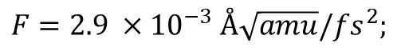
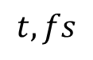
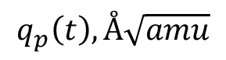
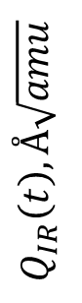

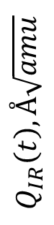
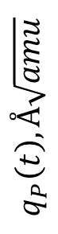
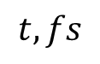
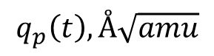
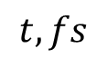
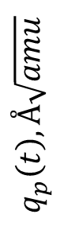
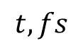
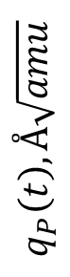
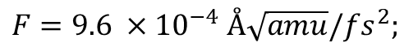
(A)
$$μ=0.04 fs^{−1}$$
0.2
$$F=9.6 ×{10}^{−4} Å\sqrt{amu}/fs^{2};$$
-1.075
1.0
0.1
0.5
$$Q_{IR}\left(t\right), Å\sqrt{amu}$$
$$q_{p}\left(t\right), Å\sqrt{amu}$$
$$Q_{IR}\left(t\right), Å\sqrt{amu}$$
0.0
-1.000
0.0
-0.1
-0.5
-0.2
-0.925
-1.0
0
1000
2000
3000
4000
0
1000
2000
3000
4000
-1.5
-1.0
-0.5
0.0
0.5
1.0
1.5
(B)
$$t, fs$$
$$t, fs$$
$$q_{p}\left(t\right), Å\sqrt{amu}$$
$$F=2.8 ×{10}^{−3} Å\sqrt{amu}/fs^{2};$$
1.0
$$μ=0.04 fs^{−1}$$
1.0
1.0
0.5
0.5
$$Q_{IR}\left(t\right), Å\sqrt{amu}$$
$$q_{P}\left(t\right), Å\sqrt{amu}$$
$$Q_{IR}\left(t\right), Å\sqrt{amu}$$
0.0
0.0
0.0
-0.5
-1.0
-0.5
-1.0
-1.0
0
1000
2000
3000
4000
0
1000
2000
3000
4000
-1.5
-1.0
-0.5
0.0
0.5
1.0
1.5
(C)
$$t, fs$$
$$t, fs$$
$$q_{p}\left(t\right), Å\sqrt{amu}$$
$$μ=0.04 fs^{−1}$$
$$F=2.9 ×{10}^{−3} Å\sqrt{amu}/fs^{2};$$
1.0
1.0
0.75
0.5
$$q_{P}\left(t\right), Å\sqrt{amu}$$
$$Q_{IR}\left(t\right), Å\sqrt{amu}$$
$$Q_{IR}\left(t\right), Å\sqrt{amu}$$
0.0
0.0
0.0
-0.75
-1.0
-0.5
0
1000
2000
3000
4000
-1.0
0
1000
2000
3000
4000
$$t, fs$$
-1.5
-1.0
-0.5
0.0
0.5
1.0
1.5
$$t, fs$$
$$q_{p}\left(t\right), Å\sqrt{amu}$$

Slide 5
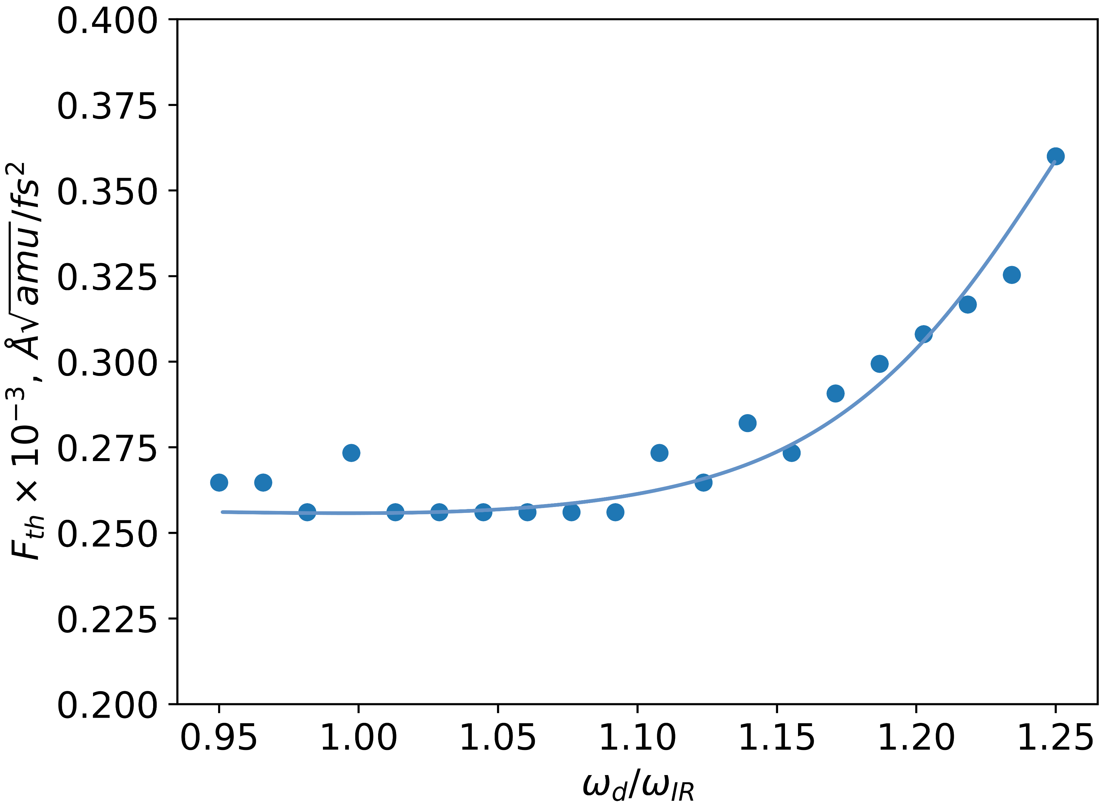

Slide 6
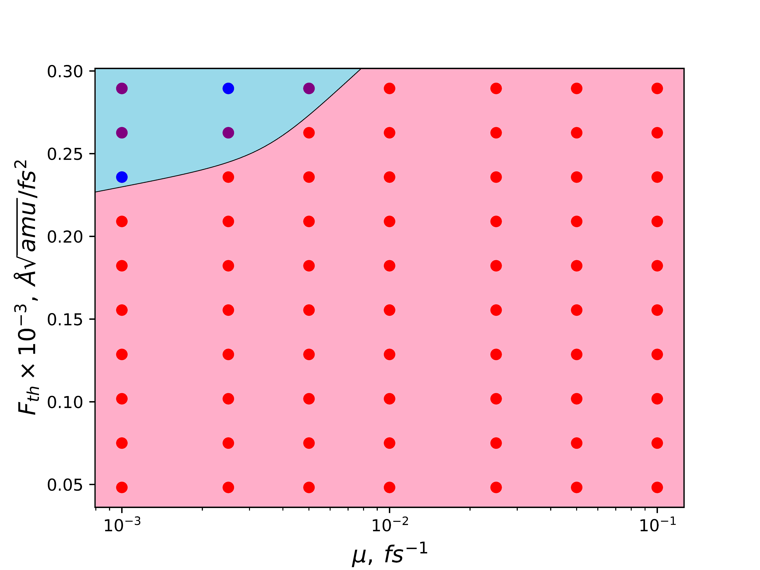
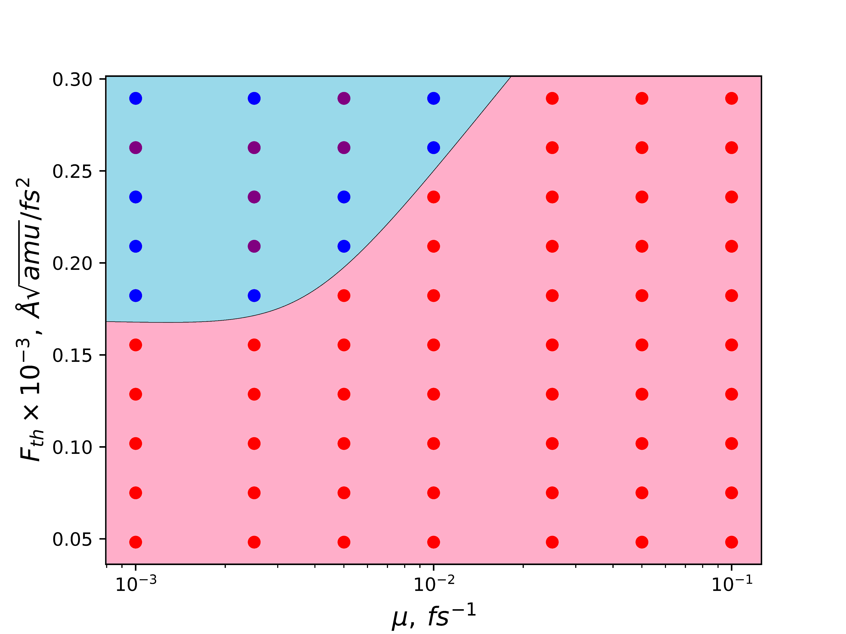













(A)
$$τ=250 fs$$
(B)
$$τ=350 fs$$
(C)
$$τ=450 fs$$
0.3
0.3
0.3
0.2
0.2
0.2
$$F_{th}×{10}^{−3}, Å\sqrt{amu}/fs^{2}$$
$$F_{th}×{10}^{−3}, Å\sqrt{amu}/fs^{2}$$
$$F_{th}×{10}^{−3}, Å\sqrt{amu}/fs^{2}$$
0.1
0.1
0.1
$${10}^{−3} {10}^{−2} {10}^{−1}$$
$${10}^{−3} {10}^{−2} {10}^{−1}$$
$${10}^{−3} {10}^{−2} {10}^{−1}$$
$$μ, fs^{−1}$$
$$μ, fs^{−1}$$
$$μ, fs^{−1}$$

